Slide 1
Screening for CKD
using Logistic Regression

Slide 2
Agenda
01
Introduction
02
Data Exploration
03
Model
04
Screening Tool
05
Conclusion

Slide 3
Introduction
Objective To develop an easy to use screening tool that identifies patients who are at higher risk of developing CKD based on various factors.
Chronic kidney disease includes conditions that damage your kidneys and decrease their ability to keep you healthy. When kidney disease progresses, it may eventually lead to kidney failure, which requires dialysis or a kidney transplant to maintain life.
37M
American adults have CKD and millions of others are at increased risk.
Hypertension & Diabetes
Heart Condition
The two main causes of chronic kidney disease are diabetes and high blood pressure.
Heart disease is the major cause of death for all people with CKD.

Slide 4
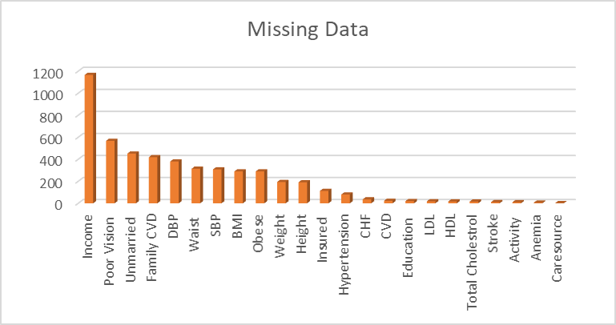
Data Exploration
According to the data, Age, Hypertension and Diabetes were positively correlated to CKD.
The nature of the data is imbalanced since only 464 out of 6000 have CKD and might produce biased predictions.
From literature survey, black and Hispanic are more prone to CKD but in data, they are underrepresented.
In total, there is 2.6% missing data.
Variables insignificant to CKD like Income, Unmarried, Insured, Care Source, Education can be removed.

Slide 5
Model Timeline
Analytics &, Research
used LASSO package, literature survey and consulted Nephrologist to finalize the variables
Logistic Regression
Used to test the built model on two sets of 1000 people
Predictive
Model
Final
Prediction
Imputation
Variable
Selection
Validation
MICE Package
Logistic Regression
Logistic Regression
with Predictive Mean Matching method to fill the missing data
Used to train the model using Training set of 4000 people
Used to final model to predict for 2819 people

Slide 6
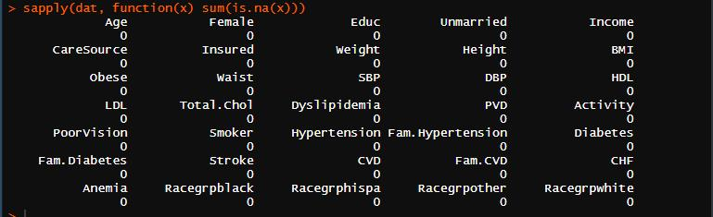
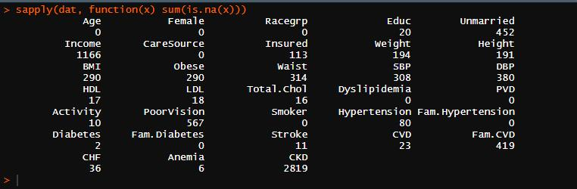
Imputation
Before Imputation
After
Imputation

Slide 7
Variable Selection
Literature Survey
Correlation Matrix
Referred to medical articles, textbooks and research papers.
LASSO
LASSO- Embedded Approach Approach
To obtain the subset of predictors that minimizes prediction error for a quantitative response variables.
Doctor’s Recommendation
Doctor’s Recommendation
Correlation Matrix
Removed the least correlated and insignificant variables.
Criterion Based Approach
Criterion Based Approach
Main focus is to reduce the AIC.
Literature Survey

Slide 8
Brainstorming Our Final Variables
Variables
Age
BMI
PVD
Anemia
Fam Diabetes
Fam CVD
Race group (Black)
Variables
Female
Dyslipidemia
Hypertension
Diabetes
Stroke
CHF
Race group (Hispanic)

Slide 9
Logit Model Framework
CKD Data Set
Consist of 8819
observations
AIC
1482
Training Set
Prediction Set
Consist of 6000 observations with value for CKD
Consist of 2819 observations for predicting CKD
Content Here
You can simply impress your audience and add a unique zing and appeal to your Presentations. Get a modern PowerPoint Presentation that is beautifully designed.
Train Set
Test Set
Validation Set
4000 observations
1000 observation
1000 observation
Content Here
You can simply impress your audience and add a unique zing and appeal to your Presentations. Get a modern PowerPoint Presentation that is beautifully designed. Easy to change colors, photos and Text. I hope and I believe that this Template will your Time, Money and Reputation.

Slide 10
Testing the Data
Confusion Matrix:
 | Actual : Yes | Actual : No
Predicted : Yes | 65 | 216
Predicted : No | 12 | 707
AUC
Accuracy
82%
77.2%.

Slide 11
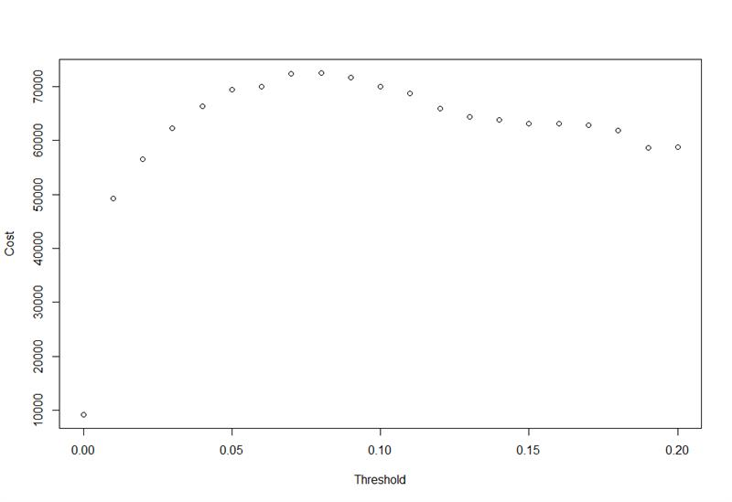
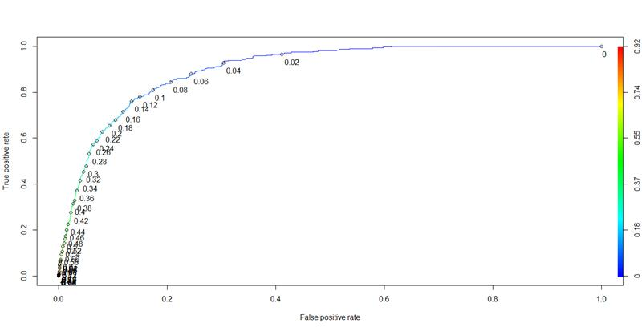
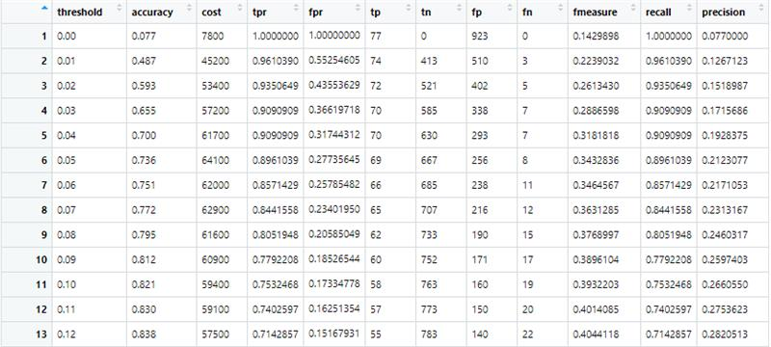
We picked a threshold of 0.07 in order to maximize the true positives and minimize the false positive.
Threshold
Selection
We could also achieve the maximum accuracy and maximum money at this threshold.
Number of True Positive- 65 Number of False Positive- 216

Slide 12
Validation of the data
Confusion Matrix:
 | Actual : Yes | Actual : No
Predicted : Yes | 72 | 212
Predicted : No | 6 | 710
Accuracy
78.2%.

Slide 13
“We Predict 813/2819 people have CKD”

Slide 14
SCREENING
TOOL
Want to find out if you’re at
risk to develop CKD?
Take this test now!!

Slide 15
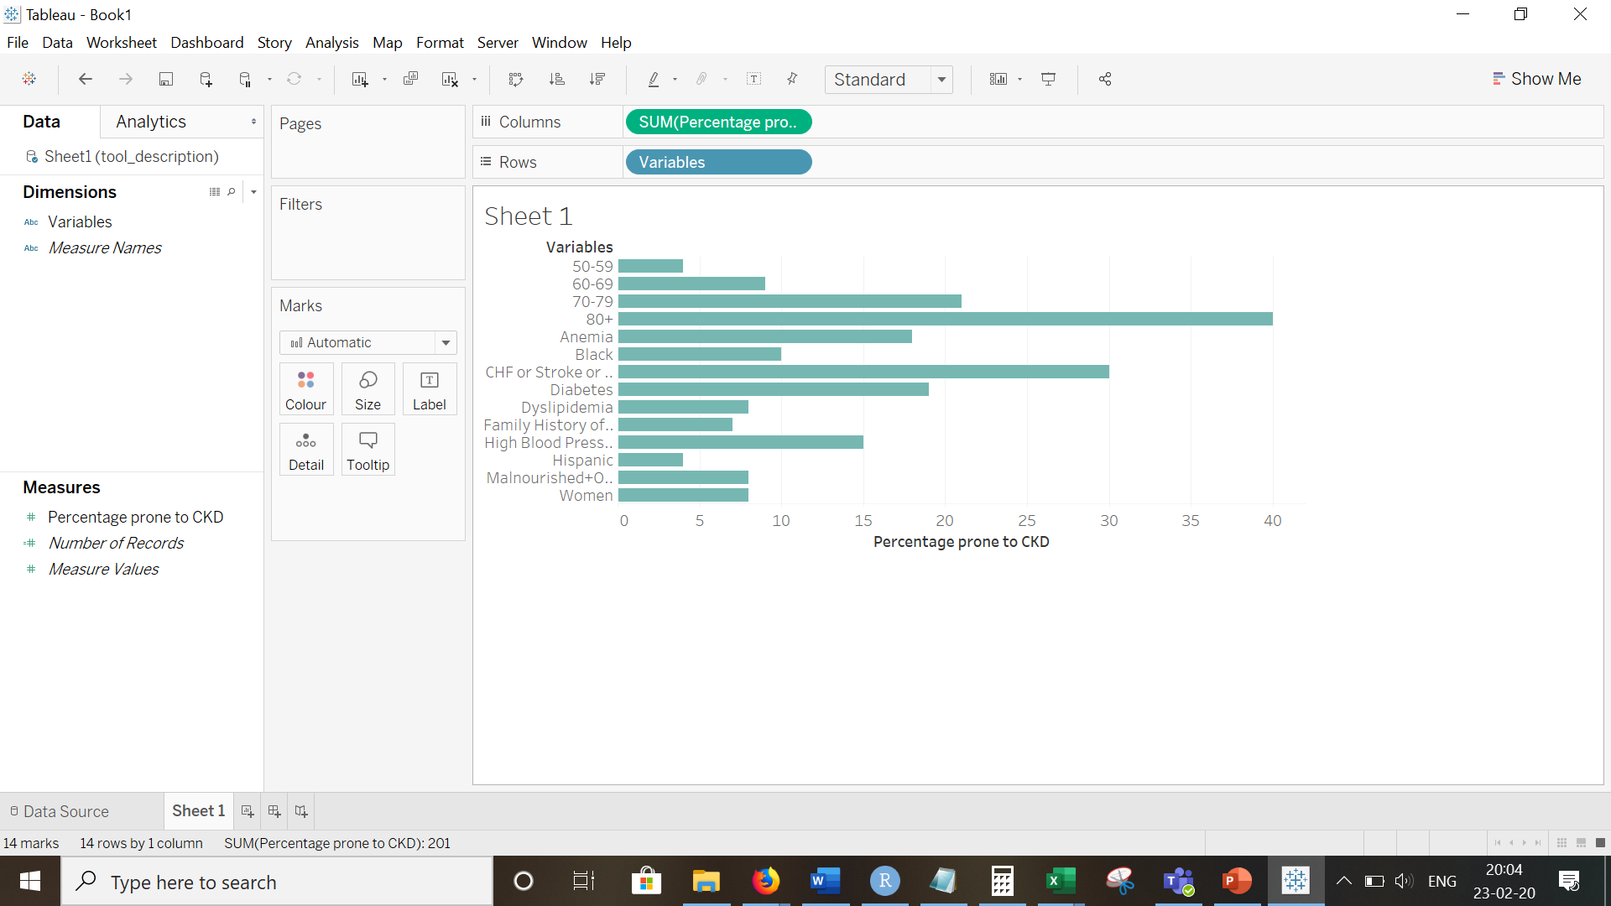
DESCRIPTION
SURVEY

Slide 16
Limitations
The data set doesn’t talk about the severity of CKD (Symptoms like CVD develop only at the final stage. So, if a person who is prone to CKD might not have CVD at the initial stage).
Data about main causes of CKD are missing (Protein Urea, IHD, eGFR). Two simple tests can detect CKD urine, albumin and serum, creatinine. We don’t have these in the data set.
The variables selected might not be the best combination as more research work is needed on each variable.
Imbalance in the data set -We have less people with CKD. This will lead to bias again.

Slide 17

Any Questions?
Thank You!

